Slide 3
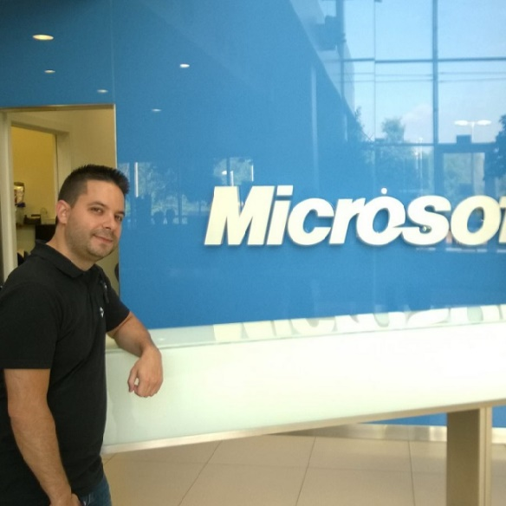


Alberto Pascual
Microsoft
Exchange Support Engineer
Nacho Sánchez-Beato
Microsoft
Exchange Support Escalation Engineer
http://blogs.technet.com/b/esexblog

Slide 4
Meet Exchange 2016 & Exchange on IaaS

Slide 5
Caveats
Dates and features are subject to change
Pricing of new capabilities is yet to be determined
Screenshots enlarged to show texture
Professional demoer on closed course
Use only as directed
Disclaimer
This presentation contains preliminary information that may be changed substantially prior to final commercial release of the software described herein. The information contained in this presentation represents the current view of Microsoft Corporation on the issues discussed as of the date of the presentation. Because Microsoft must respond to changing market conditions, it should not be interpreted to be a commitment on the part of Microsoft, and Microsoft cannot guarantee the accuracy of any information presented after the date of the presentation. This presentation is for informational purposes only. MICROSOFT MAKES NO WARRANTIES, EXPRESS, IMPLIED OR STATUTORY, AS TO THE INFORMATION IN THIS PRESENTATION. Microsoft may have patents, patent applications, trademarks, copyrights, or other intellectual property rights covering subject matter in this presentation. Except as expressly provided in any written license agreement from Microsoft, the furnishing of this information does not give you any license to these patents, trademarks, copyrights, or other intellectual property. © 2015 Microsoft Corporation. All rights reserved.

Slide 6
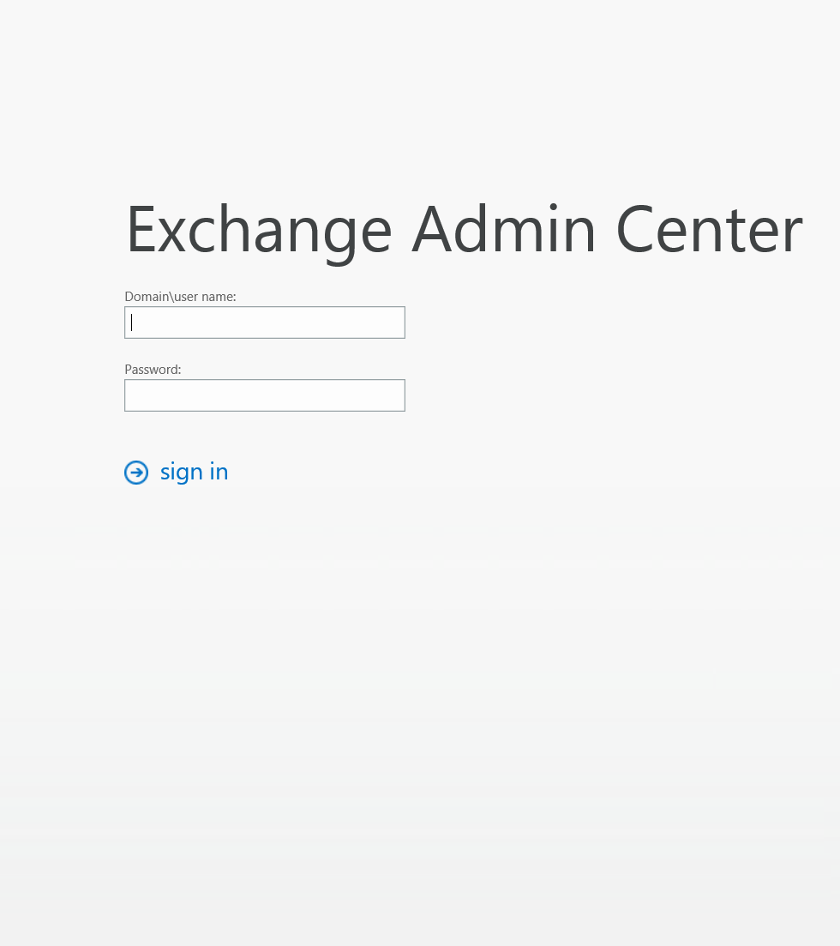
Meet Exchange 16

Slide 7
New features
Better collaboration
Smarter inbox
Modern datacenter
Performance and reliability
Security and compliance

Slide 8
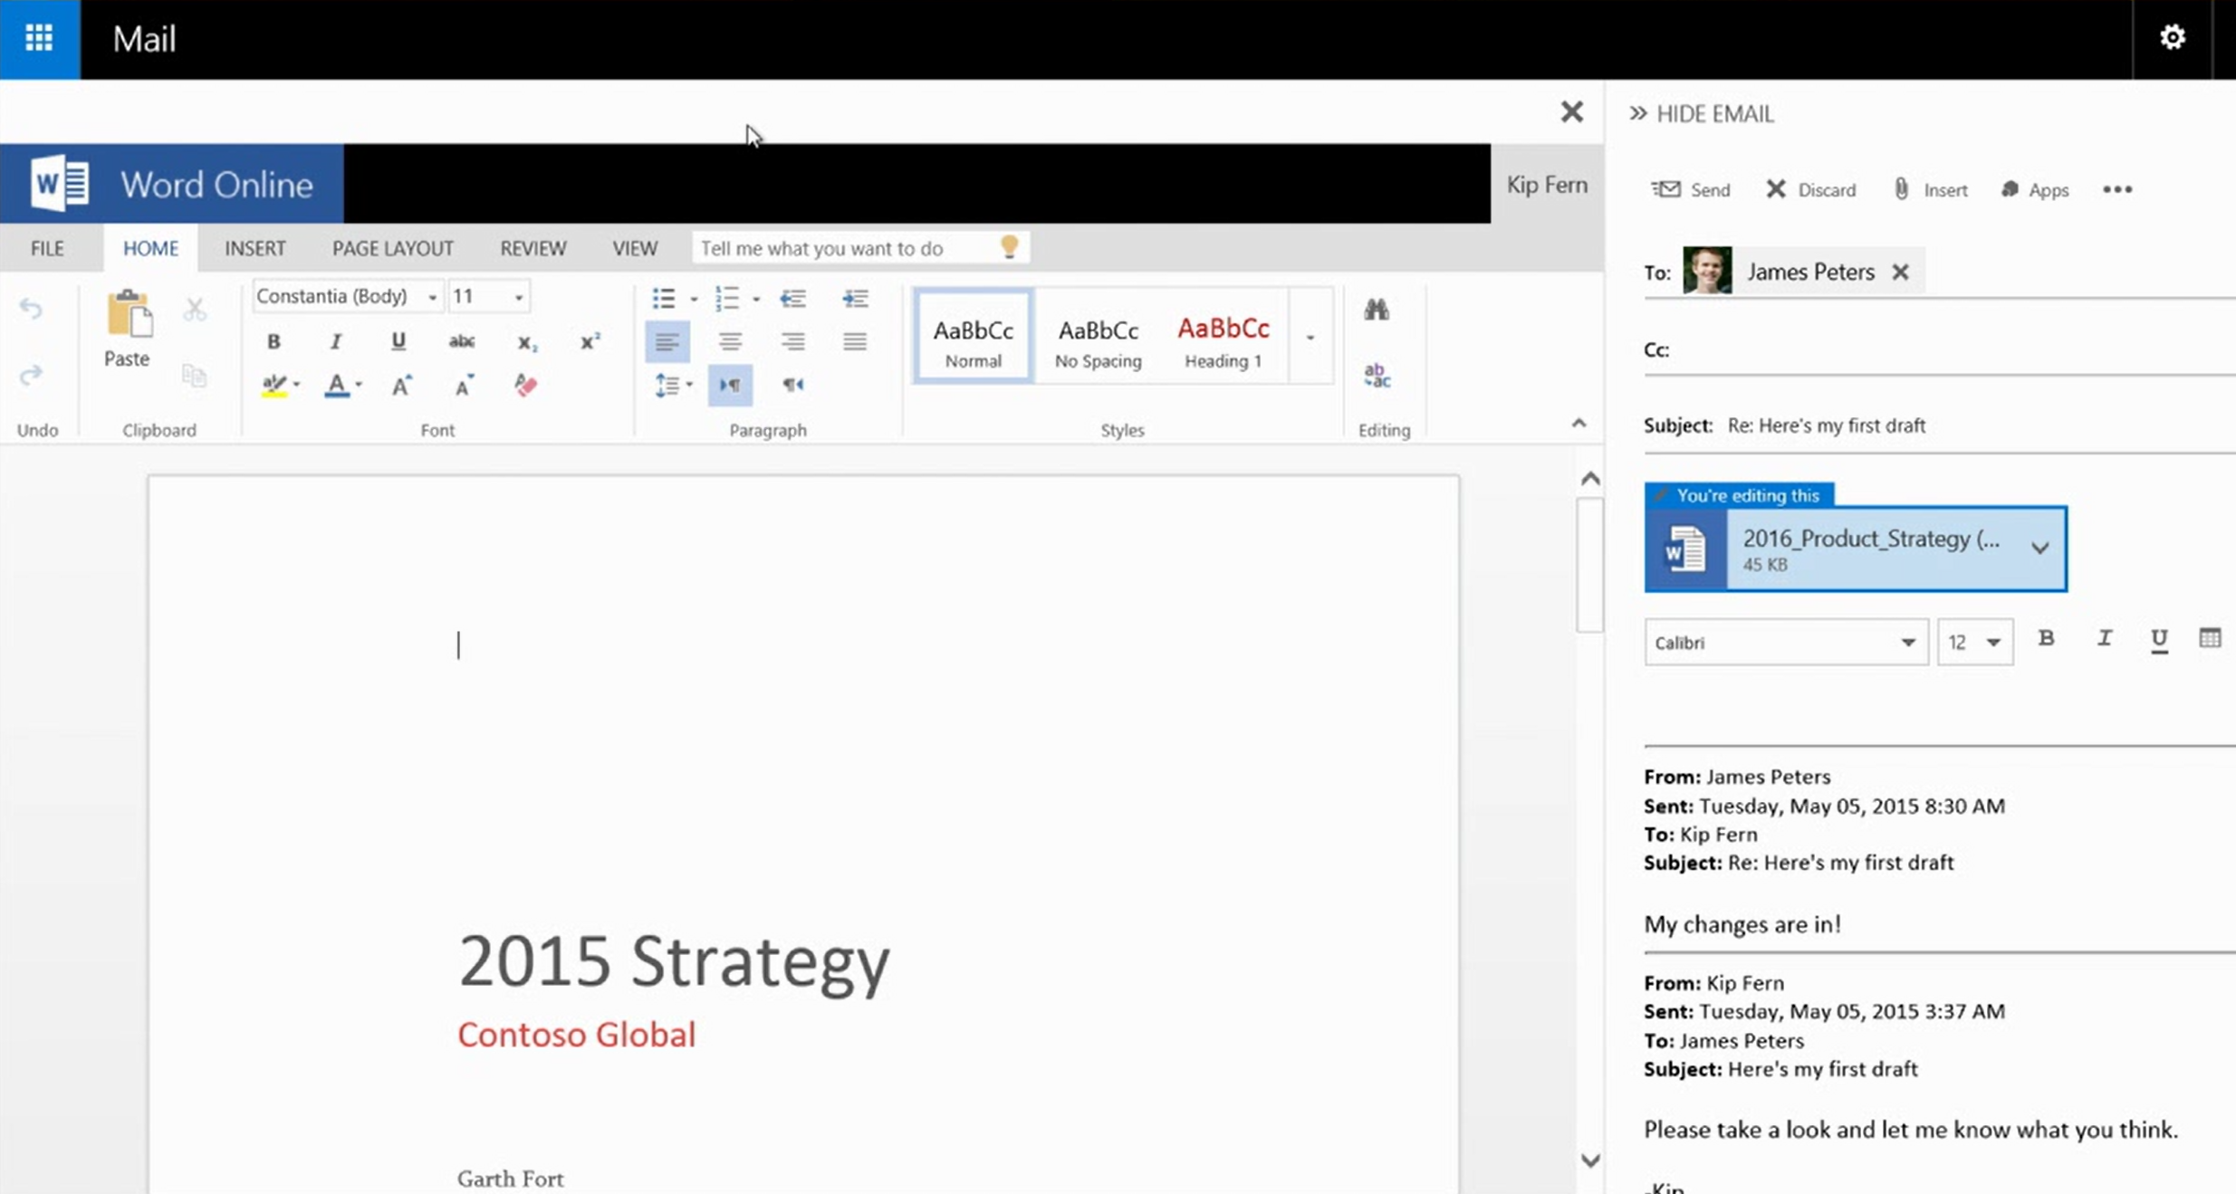
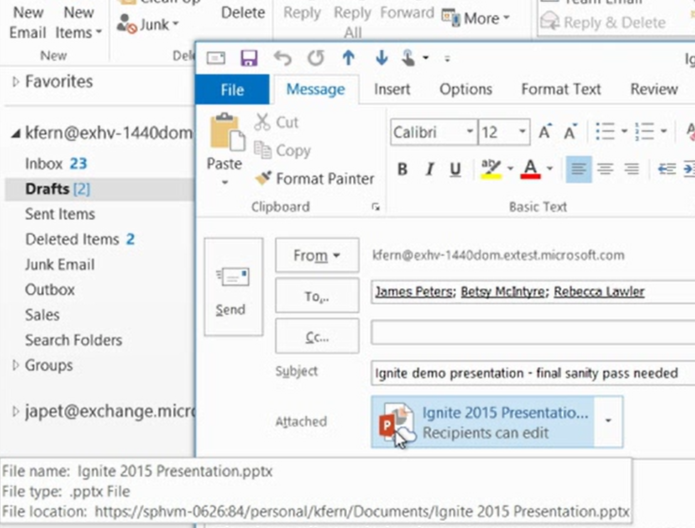
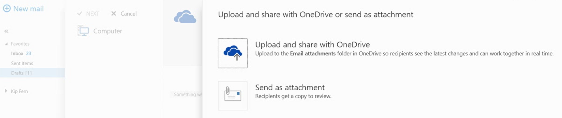
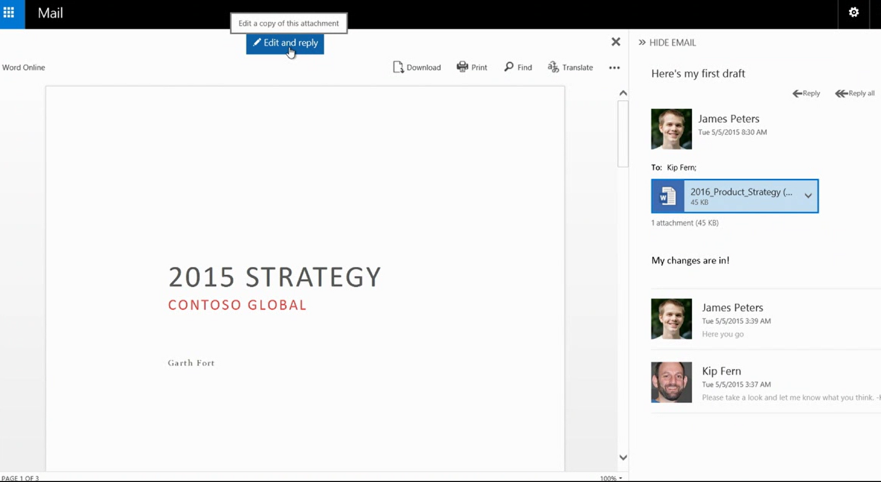
Better collaboration
Onedrive and Sharepoint integration

Slide 9

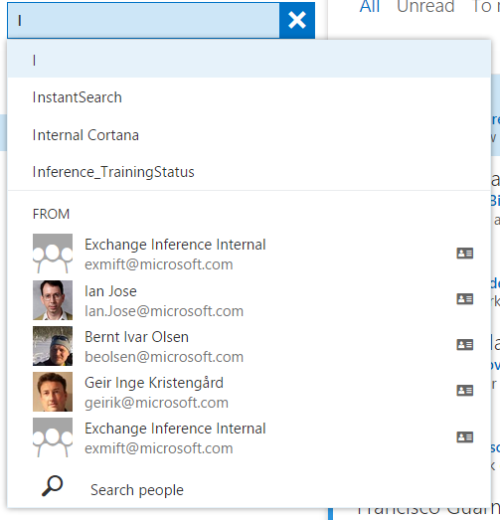
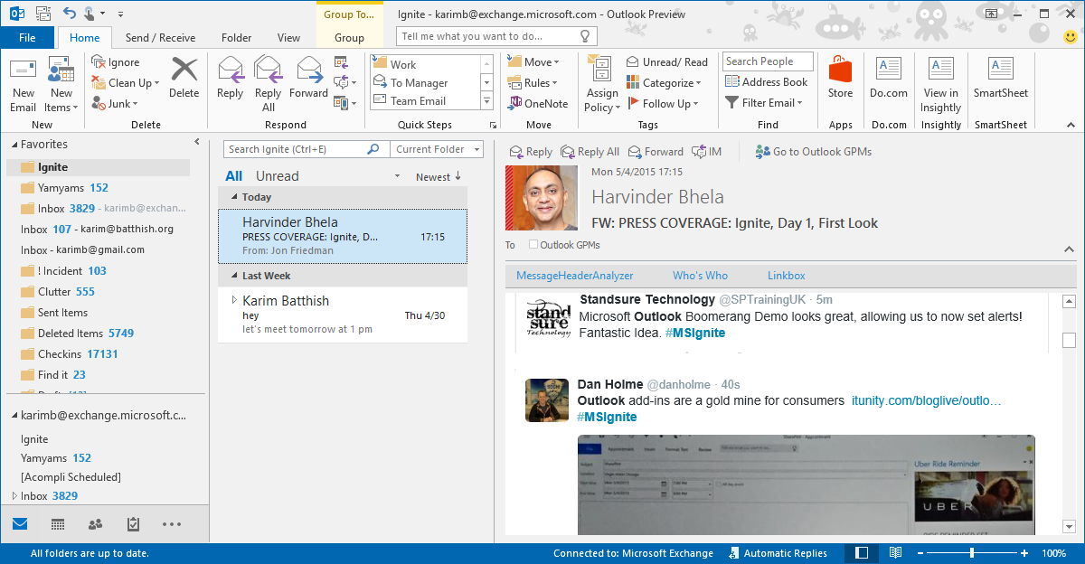
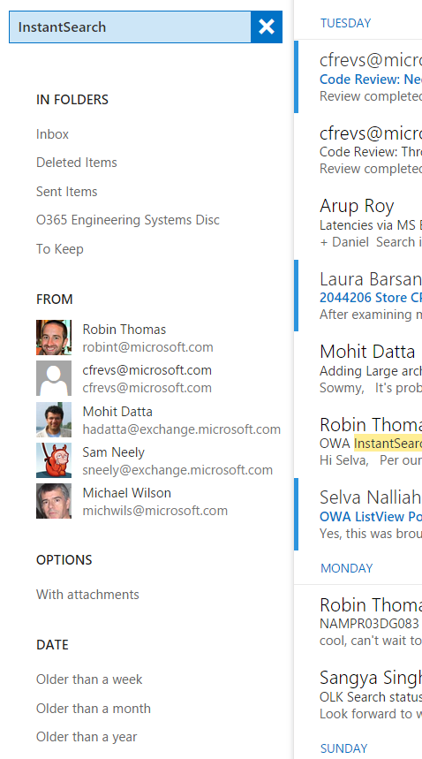
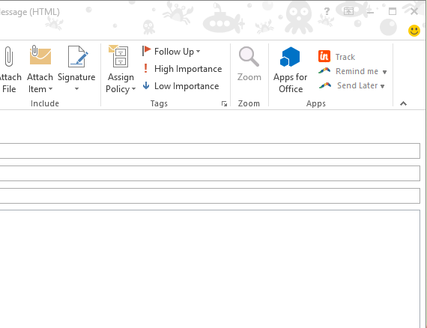
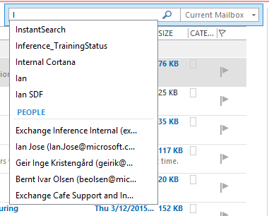
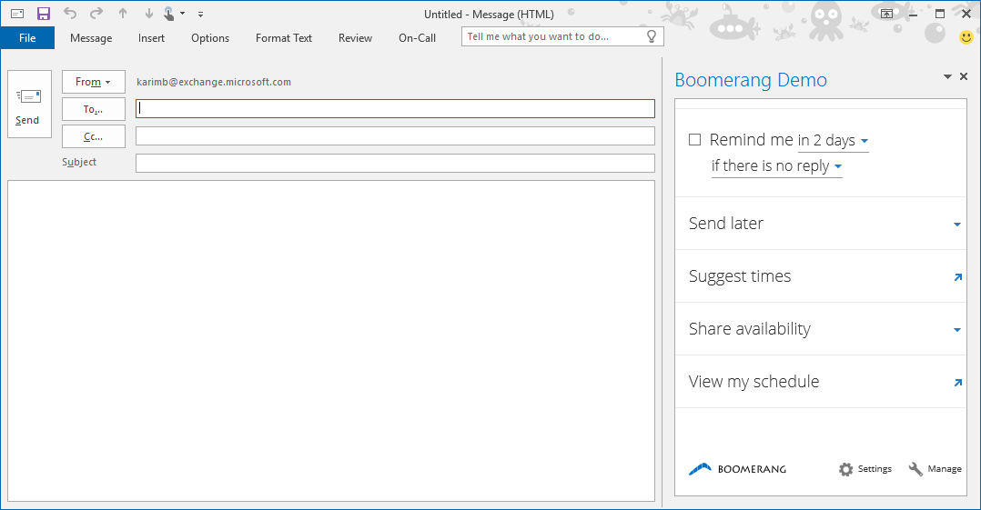
Smarter inbox
Faster, easier search
Extensibility
Tame email overload with tools that help you focus on what’s important and work more efficiently

Slide 10
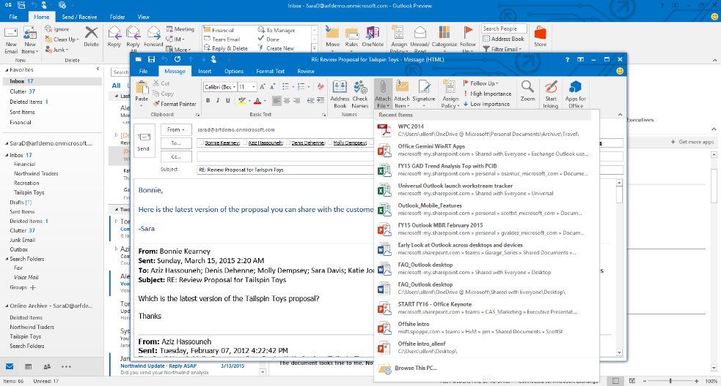
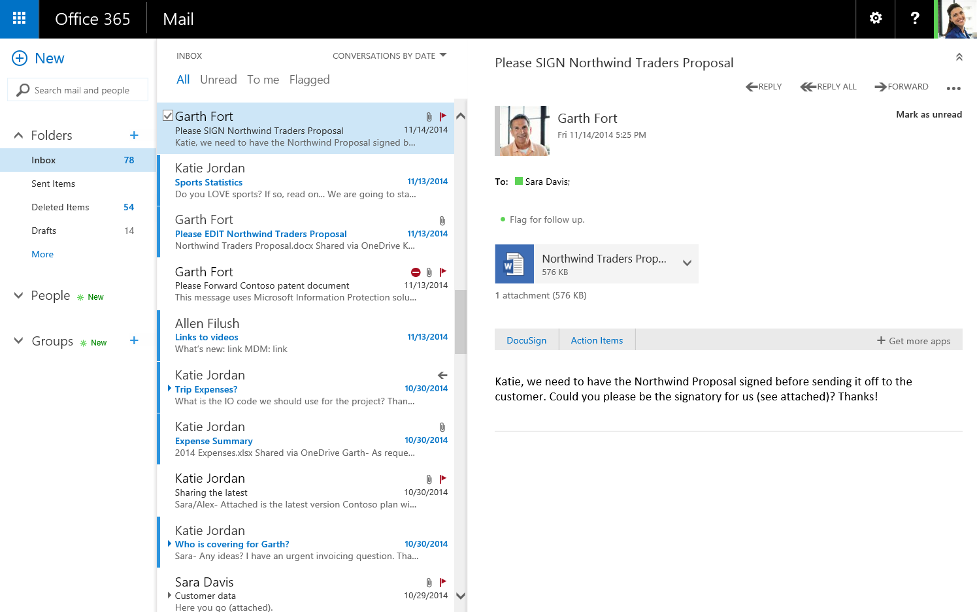
Smarter inbox
Inbox enhancements
Inline previews for URLs
Inline video player
Intelligent recipient selection and people search
“Tell me what you want to do” box in Outlook
Improved HTML rendering
One-click archive
Common typos/suggestions
Contact linking improvements
Import contacts from csv
Better format controls
Smarter actions button
Better attachment view
Pin
Undo
Sweep
Weather view
Emojis
Single line view
Inline reply
Insert images

Slide 11

Modern datacenter
Reduced WAN costs - Search index using passive copy
Supports bigger disks with less IOPS (>22% lower than E15 RTM)
8 TB, 7200 RPM JBOD
Delayed lag play-down
Automated Repair
Find database corruptions via DB divergence detection
Loose Truncation – long-term outages out-of-space won’t dismount DB
ReFS Support – Decrease FS corruption, reseeds and rebuilds
Faster Recovery (now even more HA)
Faster database *overs (95%ile @ 18s)
Faster site resilience: Database copy activation suspended and Move Now
DAG Management Service – reducing failure domains
Replay Lag Manager on by default – auto-play down when insufficient avail copies
Simpler deployments
DAGs without cluster administrative access points
Max Preferred Actives – soft limit for better balancing
Azure file share witness
Get-MailboxServerRedundancy, a way to prioritize hardware repairs and make upgrades easier
Performance and reliability

Slide 12
Get-MailboxServerRedundancy -DatabaseAvailabilityGroup Europe01
Identity RepairUrgency SafeForMaintenance
-------- ------------- ------------------
FCO-MB0009 Prohibited False
FCO-MB0010 Prohibited False
FCO-MB0011 Critical False
FCO-MB0012 Prohibited False
FCO-MB0004 High True
FCO-MB0003 Prohibited False
FCO-MB0001 Normal True
FCO-MB0002 Critical False
MXP-MB0016 Prohibited False
MXP-MB0014 High True
MXP-MB0015 Normal True
MXP-MB0013 Prohibited False
MXP-MB0006 High True
MXP-MB0008 High True
MXP-MB0007 Prohibited False
MXP-MB0005 Prohibited False

Slide 13
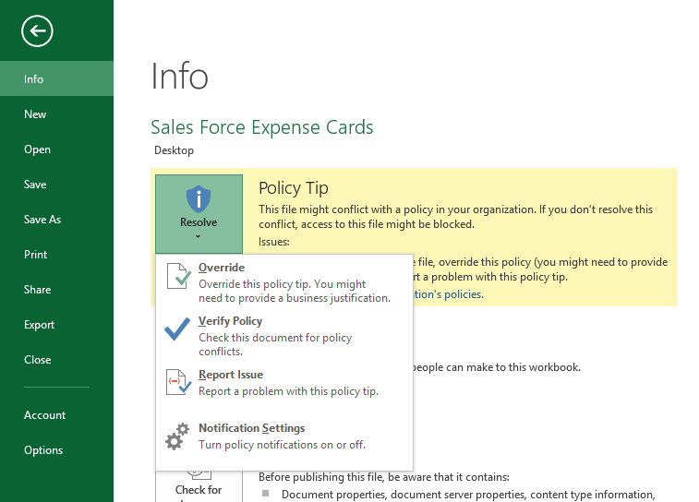
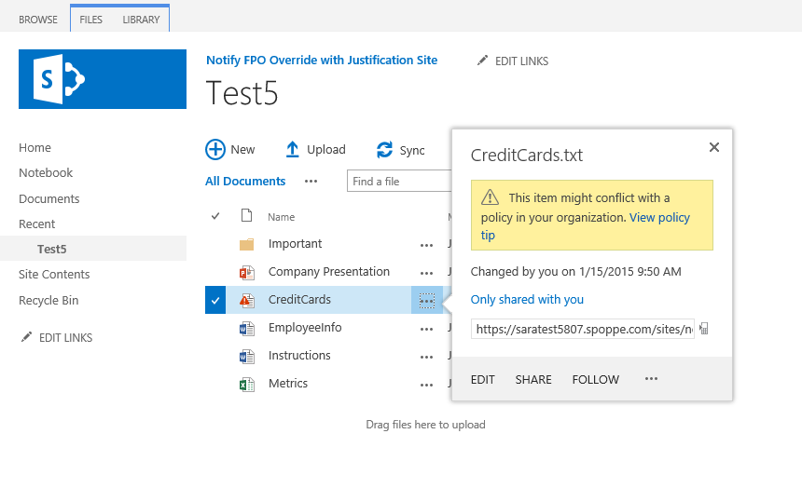

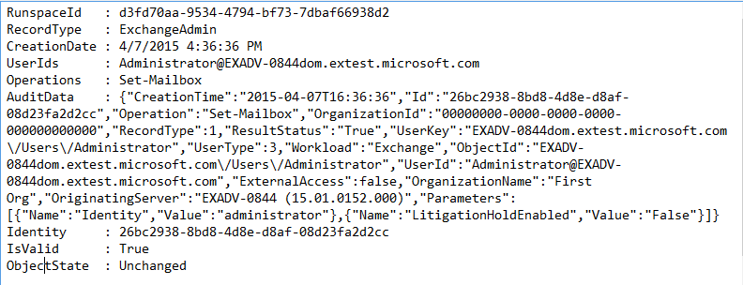
Security and compliance
Data loss prevention
Auditing
Bitlocker

Slide 14
Environment requirements
Exchange 2016 supports coexistence with
Exchange 2010 SP3 RU11 and later*
Exchange 2013 CU10 and later*
Exchange 2016 requires
Windows Server 2008 R2 FFM/DFM and later
Windows Server 2008 R2 and later AD Global Catalog servers in each Exchange site
Outlook client requirements
Outlook 2010 SP2 (with KB2956191 and KB2965295)* or later
Outlook 2013 SP1 (with KB3020812)* or later
Outlook 2016
Outlook for Mac 2011 or later
No longer supported
Outlook 2007, Outlook for Mac 2008 EWS Edition
MAPI/CDO Package
* Subject to change

Slide 15
Server requirements
Exchange 2016 is supported on full GUI installs of
Windows Server 2012 R2
Windows Server 10
Exchange 2016 requires
.NET Framework 4.5.2 or later*
Windows Management Framework 4.0*
Unified Communications Managed API (UCMA) 4.0*
Office Web Apps Server for in-OWA attachment rendering installed on separate server(s)
* Subject to change

Slide 16
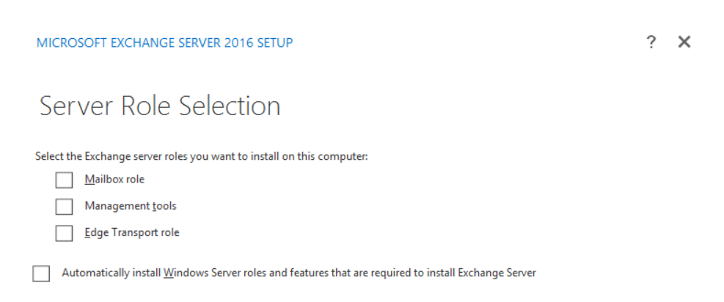
Roles re-defined

Slide 17
Release Timeline
YOU ARE HERE
@CEUS
First dogfood mailbox deployed
Technology Adoption Program kickoff
Public beta
Final release
Nov 2014
Feb 2015
June 2015
Summer 2015
Fall/Winter 2015

Slide 18

Exchange on IaaS

Slide 19
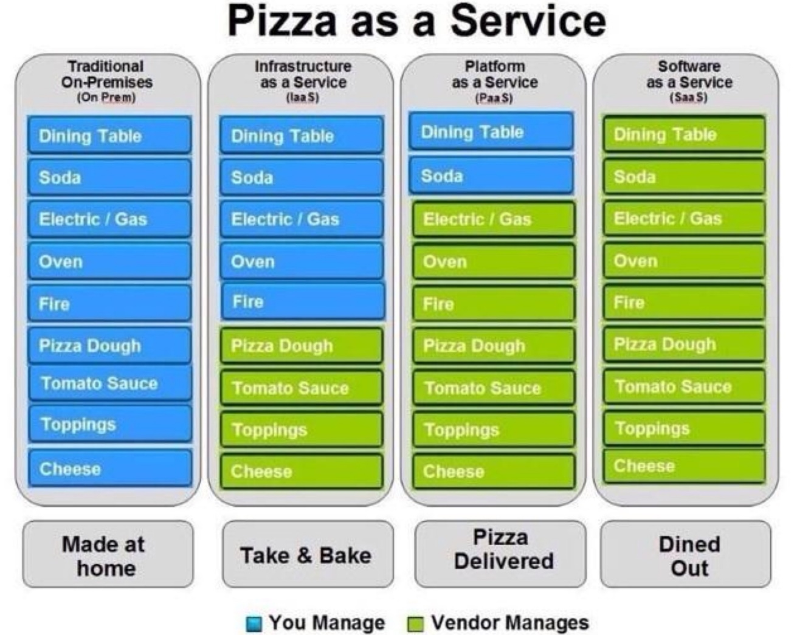
IaaS vs. SaaS

Slide 20


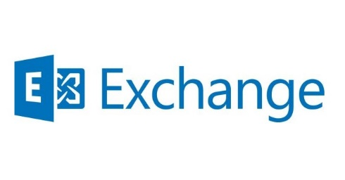

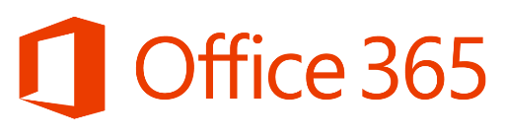
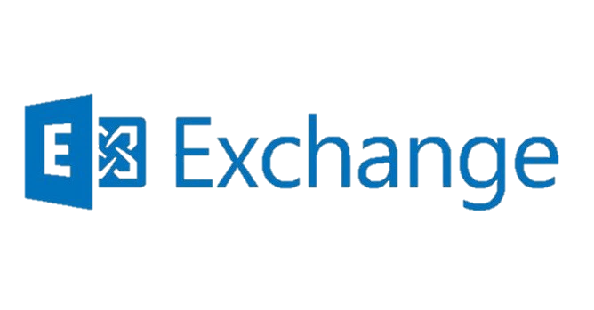
IaaS vs. SaaS (II)
On-Prem
Infrastructure
(as a Service)
Platform
(as a Service)
Software
(as a Service)
You manage
Applications
Applications
Applications
Applications
Data
You manage
Data
Data
Data
Runtime
Runtime
Runtime
Runtime
Managed by Microsoft
You manage
Middleware
Middleware
Middleware
Managed by Microsoft
Middleware
O/S
O/S
O/S
O/S
Virtualization
Virtualization
Managed by Microsoft
Virtualization
Virtualization
Servers
Servers
Servers
Servers
Storage
Storage
Storage
Storage
Networking
Networking
Networking
Networking
Notes:
Slide Objectives
Explain the differences and relationship between IaaS, PaaS, and SaaS in more detail
Speaker Notes
Another way to look at the cloud services taxonomy and how this taxonomy maps to the components in an IT infrastructure is as follows:
Packaged software: With packaged software, a customer would be responsible for managing the entire stack, ranging from the network connectivity to the applications
IaaS:
With IaaS, the lower levels of the stack are managed by a vendor. Some of these components can be provided by traditional hosters. In fact, most of them have moved to a virtualized offering
Very few actually provide an OS
The customer is still responsible for managing the OS through the applications
An obvious benefit with IaaS is that it frees the developer from many concerns when provisioning physical or Virtual Machines (VMs)
This was one of the earliest and primary use cases for Amazon Web Services Elastic Cloud Compute (EC2)
Developers were able to readily provision VMs (Amazon Machine Images, abbreviated as AMIs) on EC2, develop and test solutions and, often, run the results in production
The only requirement was a credit card to pay for the services
PaaS:
With PaaS, everything from the network connectivity through the runtime is provided and managed by the platform vendor
Microsoft Azure fits best in this category today
In fact, because we do not provide access to the underlying virtualization or OS today, we are often referred to as not providing IaaS
PaaS offerings further reduce the developer burden by additionally supporting the platform runtime and related application services
With PaaS, the developer can immediately begin creating the business logic for an application
Potentially, the increase in productivity is considerable. In addition, since the hardware and operational aspects of the cloud platform are also managed by the cloud platform provider, applications can quickly be taken from an idea to reality
SaaS:
Finally, with SaaS, a vendor provides the application and abstracts you from all of the underlying components
[EDITOR] Biju
04 October 2013 Kindly provide substantiation for the claim made against third-party software.

Slide 21
Not for everyone
First and best option: Exchange Online (Office 365)
Research is focused on Office 365
New features and caracteristics are taken to Exchange Server if they make sense
On-prem deployments over physical HW can be cheaper than IaaS
http://aka.ms/preferred
SLA 99,95% guaranteed (4.38 hours/year)
We want to give the option to choose to our customers the highest flexible levels on their deployments.
Exchange on Azure IS NOT “Exchange on the cloud”

Slide 22
Exchange on Azure
Possible scenarios:
A whole organization on Azure
DAG stretched On-Prem and Azure (DR)
DAG Witness on Azure

Slide 23
Requirements
Supported Exchange versions:
Exchange 2013
Exchange 2016
Premium Storage completely needed
Available on DS and G plans
All DBs and logs should be on premium storage
Including transport DB

Slide 24
Demo: Exchange on IaaS
Notes:
Conectar al Portal
Enseñar la configuración de las VMs
Almacenamiento
Load Balancing
Availability Set
OWA
Conectar y enviar un par de correos
Failover DB al apagar la VM

Slide 25
Q&A

Slide 26
Alberto Pascual
Microsoft
Exchange Support Engineer
Nacho Sánchez-Beato
Microsoft
Exchange Support Escalation Engineer
http://blogs.technet.com/b/esexblog

